Slide 1
Platform products
Vishay Basic training
IHLP power inductors
Low DCR, reduced EMI / Size

Slide 2



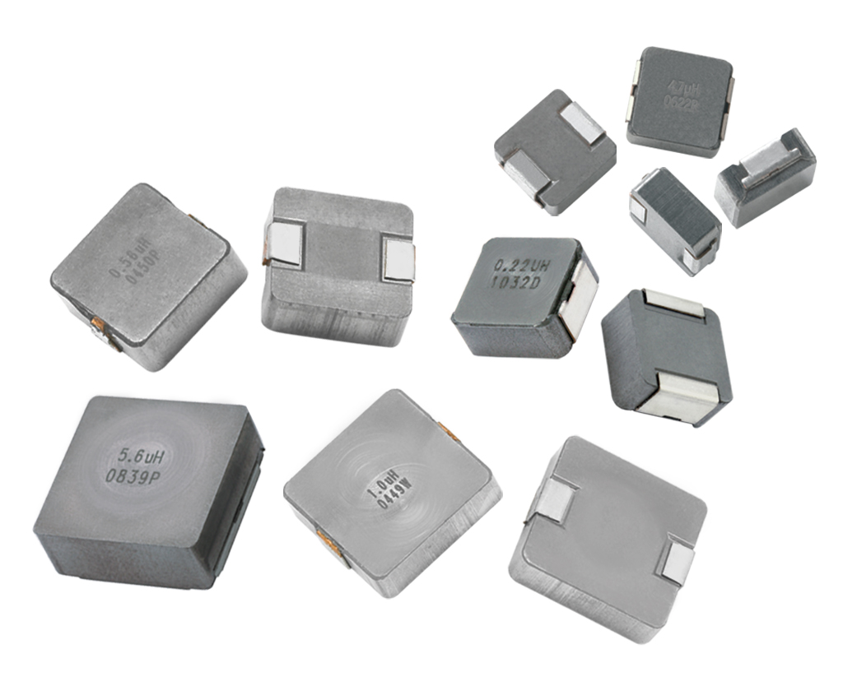

Speed controls / motor drivers
Pulse
Width
Modulated
Speed
Control
DC
Motor
EMI Filter
IHLP®
IHLP®
IHLP® Power Inductors
EMI & Noise Filtering
at high temperature
Product family | Advantage | Benefit to the Engineer | Where should it be considered | Best parameter / example
IHLP power inductors | Low saturation and high frequency filtering | Significant reduction in radiated noise - EMI (ElectroMagnetic Interference) | Where customers are driving motors and also used in automotive applications | +180C version (suffix -8A) Nine case sizes 1212-8787, lowest profile height 1 mm
Other customer benefits | How is this achieved? | Example device / details
Space-saving PCB footprint and profile height versus leaded and competing SMD versions | Composite construction, reduces size, provides low DCR (Direct Current Resistance) | Extremely limited competition for 6767 and 8787 versions
Eliminates the need for expensive through-hole products and the associated assembly issues | Construction methodology | Rated current = 5 to 100 Amps in a surface mount package

Slide 3



Battery operated equipment
Input
Filter
DC/DC
Converter
Output
Filter
Load
IHLP®
IHLP®
IHLP®
IHLP® Power Inductors
Energy Storage Inductor
Product family | Advantage | Benefit to the Engineer | Where should it be considered | Best parameter / example
IHLP power inductors | Highest efficiency due to low DCR (Direct Current Resistance) over a wide range of operating frequencies | Low DCR results in improved efficiency and longer battery life IHLP offers a significant reduction in radiated noise - EMI (Electromagnetic interference) | Where customers have batteries for power | Very low core loss up to 5 MHz
Other customer benefits | How is this achieved? | Example device / details
Space-saving PCB footprint and profile height | Compact size, low DCR (Direct Current Resistance) | 1212 @ 1mm, 1616 / 2020 @ 1.2mm and 2525 @1.8mm
Eliminates the need for expensive through-hole products and the associated size and assembly issues | Construction methodology | 5 to 100 Amps in a surface mount package

