Slide 1
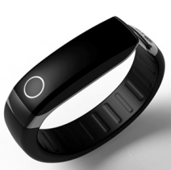
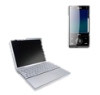
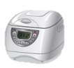


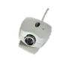


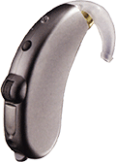

Crystal products for
the Internet of Things
MHz Crystal unit, 32KHz Tuning fork crystal, Clock oscillator and TCXO

Slide 2
AVX/Kyocera Crystal products for the Internet of Things
For Wireless application -BLE, WiFi and GPS-
MHz Crystal unit
Series Number | Package size (mm) | Freq. range (MHz) | Freq. tolerance (PPM) | Freq. stability -30 to +85C(PPM)
CX1612 | 1.6 x 1.2 | 24 - 60 | +/-10 | +/-15
CX2016 | 2.0 x 1.6 | 16 - 60 | +/-10 | +/-15
CX2520 | 2.5 x 2.0 | 12 - 54 | +/-15 | +/-15
32KHz Tuning fork crystal unit
Series Number | Package size (mm) | Freq. tolerance (PPM) | Freq. stability -30 to +85C(PPM) | ESR (Kohm)
ST2012SB | 2.0 x 1.2 | +/-20 | +/-200 | 75
ST3215SB | 3.2 x 1.5 | +/-20 | +/-200 | 70
TCXO
Series Number | Package size (mm) | Freq. range (MHz) | Freq. stability -30 to +85C(PPM) | Supply voltage (V)
KT1612A | 1.6 x 1.2 | 10 - 52 | +/-0.5 - +/-2.0 | 1.68 - 3.63
KT2016K | 2.0 x 1.6 | 10 - 52 | +/-0.5 - +/-2.0 | 1.68 - 3.63
KT2520K | 2.5 x 2.0 | 10 - 52 | +/-0.5 - +/-2.0 | 1.68 - 3.63
KT3225K | 3.2 x 2.5 | 10 - 52 | +/-0.5 - +/-2.0 | 1.68 - 3.63
For MCU / Application processor
MHz Crystal unit
Series Number | Package size (mm) | Freq. range (MHz) | Freq. tolerance (PPM) | Freq. stability -30 to +85C(PPM)
CX1612DB | 1.6 x 1.2 | 24 - 60 | +/-10 | +/-15
CX2016DB | 2.0 x 1.6 | 16 - 60 | +/-10 | +/-15
CX2520DB | 2.5 x 2.0 | 12 - 54 | +/-15 | +/-15
CX3225SB | 3.2 x 2.5 | 12 - 54 | +/-15 | +/-15
Clock oscillator
Series Number | Package size (mm) | Freq. range (MHz) | Freq. stability -30 to +85C(PPM) | Supply voltage (V)
KC2016K | 1.6 x 1.2 | 10 - 52 | +/-0.5 - +/-2.0 | 1.68 - 3.63
KC2520K | 2.0 x 1.6 | 10 - 52 | +/-0.5 - +/-2.0 | 1.68 - 3.63
KC3225K | 2.5 x 2.0 | 10 - 52 | +/-0.5 - +/-2.0 | 1.68 - 3.63

Slide 3

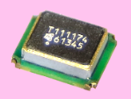

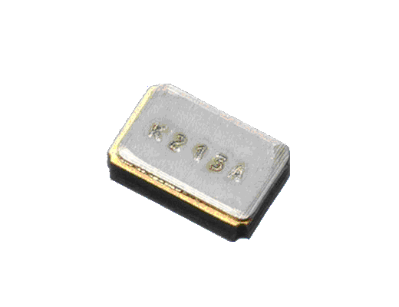
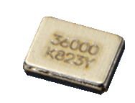
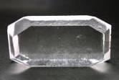
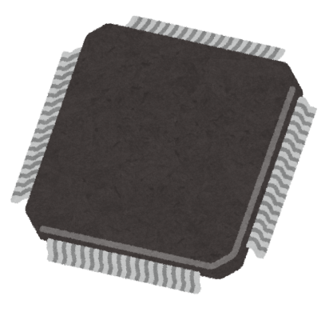
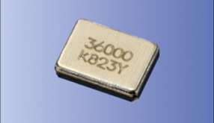
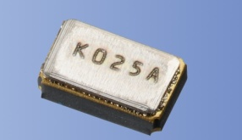
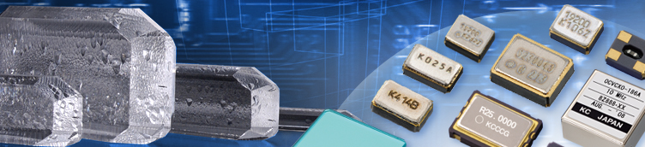
AVX Passive Components for the Internet of Things
Most IoT MCU / Connectivity chips currently require small and high precision crystal products, such as crystal unit, clock oscillator and TCXO. Kyocera is the only company who provides the in-house vertical supply-chain of synthetic quartz crystals, crystal units and ceramic packages. This gives us a great advantage in manufacturing cost compared with the competitors. Our emphasis is on high end crystal units that require tight frequency stability in smaller packages targeting IoT devices.
The diagram below shows the necessity of crystal units on BLE application which is required by IoT device.
Clock Management
MHz crystal unit for main clock
16MHz 24MHz
32MHz
HFCLK
BLE IC
KHz crystal unit for sleep clock
LFCLK
32.768kHz
Most of case, 2 types of crystal units are required.
For design suggestions, part recommendations, or other assistance, please contact your local AVX sales office or visit us at www.avx.com.

